Slide 1
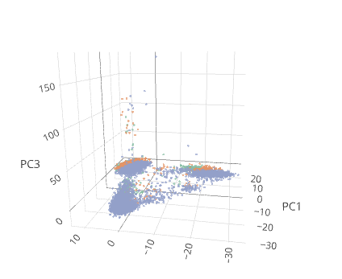



10X data raw PCA
outlier cells in 3rd PCA
3-4 main groups
samples are moderately mixed
C2RT
New 4 Analysis Stations in « Aquarius »
Notes:
The cytometry and biomarkers unit of techbnology and service gathers a team of 6 engineers, 2 technicians and 1 bioinfo who provide support to the community through …..(see under activity). The work is focused around 28 state-of-the-art technologies installed in 6 dedicated laboratories. We are iso9001 –certified since 8 years. The specificity is that the facility aims to respond to…..(see in red). The concept is appreciated by the community that counts ……(see in blue)

Slide 2
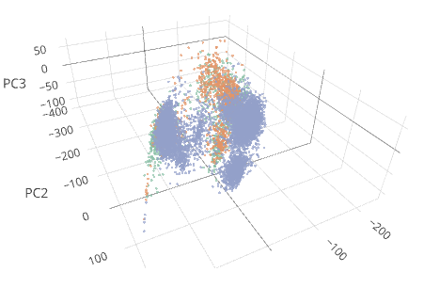
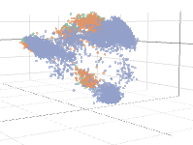
10X data DCA - PCA
outlier cells in 3rd PCA
3-4 main groups
“better” separation of samples
takes about an hour with 16 cores
C2RT
New 4 Analysis Stations in « Aquarius »
Notes:
The cytometry and biomarkers unit of techbnology and service gathers a team of 6 engineers, 2 technicians and 1 bioinfo who provide support to the community through …..(see under activity). The work is focused around 28 state-of-the-art technologies installed in 6 dedicated laboratories. We are iso9001 –certified since 8 years. The specificity is that the facility aims to respond to…..(see in red). The concept is appreciated by the community that counts ……(see in blue)

Slide 3
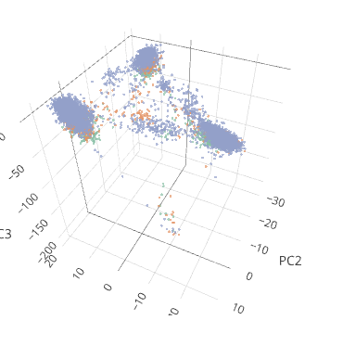
10X data 10X normalization
outlier cells in 3rd PCA
3-4 main groups
similar to no normalization
C2RT
New 4 Analysis Stations in « Aquarius »
Notes:
The cytometry and biomarkers unit of techbnology and service gathers a team of 6 engineers, 2 technicians and 1 bioinfo who provide support to the community through …..(see under activity). The work is focused around 28 state-of-the-art technologies installed in 6 dedicated laboratories. We are iso9001 –certified since 8 years. The specificity is that the facility aims to respond to…..(see in red). The concept is appreciated by the community that counts ……(see in blue)

Slide 4
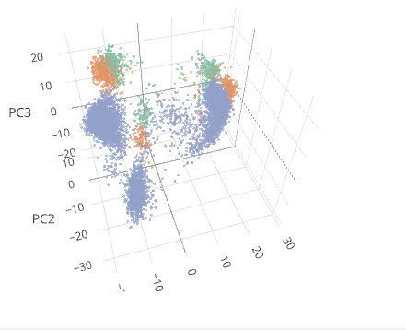
10X data – removed outliers - raw
3-4 main groups
similar to no normalization
clear separation of samples
C2RT
New 4 Analysis Stations in « Aquarius »
Notes:
The cytometry and biomarkers unit of techbnology and service gathers a team of 6 engineers, 2 technicians and 1 bioinfo who provide support to the community through …..(see under activity). The work is focused around 28 state-of-the-art technologies installed in 6 dedicated laboratories. We are iso9001 –certified since 8 years. The specificity is that the facility aims to respond to…..(see in red). The concept is appreciated by the community that counts ……(see in blue)

Slide 5
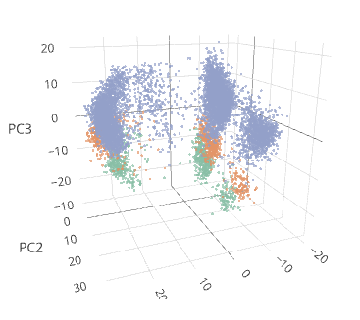
10X data – removed outliers - scater
now possible to calculate
3-4 main groups
similar to no normalization
C2RT
New 4 Analysis Stations in « Aquarius »
Notes:
The cytometry and biomarkers unit of techbnology and service gathers a team of 6 engineers, 2 technicians and 1 bioinfo who provide support to the community through …..(see under activity). The work is focused around 28 state-of-the-art technologies installed in 6 dedicated laboratories. We are iso9001 –certified since 8 years. The specificity is that the facility aims to respond to…..(see in red). The concept is appreciated by the community that counts ……(see in blue)

Slide 6
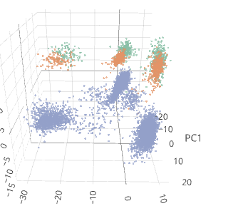
10X data – removed outliers – 10X normalization
3-4 main groups
similar to no normalization
C2RT
New 4 Analysis Stations in « Aquarius »
Notes:
The cytometry and biomarkers unit of techbnology and service gathers a team of 6 engineers, 2 technicians and 1 bioinfo who provide support to the community through …..(see under activity). The work is focused around 28 state-of-the-art technologies installed in 6 dedicated laboratories. We are iso9001 –certified since 8 years. The specificity is that the facility aims to respond to…..(see in red). The concept is appreciated by the community that counts ……(see in blue)

Slide 7
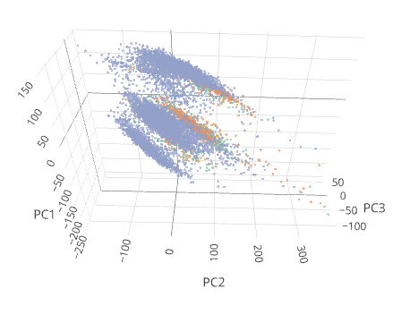
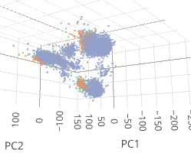
10X data – removed outliers – DCA
much more streched distributions
still samples are separated
C2RT
New 4 Analysis Stations in « Aquarius »
Notes:
The cytometry and biomarkers unit of techbnology and service gathers a team of 6 engineers, 2 technicians and 1 bioinfo who provide support to the community through …..(see under activity). The work is focused around 28 state-of-the-art technologies installed in 6 dedicated laboratories. We are iso9001 –certified since 8 years. The specificity is that the facility aims to respond to…..(see in red). The concept is appreciated by the community that counts ……(see in blue)

Slide 8
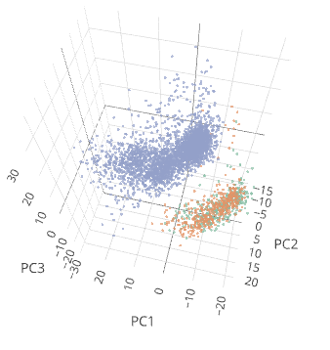
10X data – removed outliers -
focus on one group - raw
focus on one group
C2RT
New 4 Analysis Stations in « Aquarius »
Notes:
The cytometry and biomarkers unit of techbnology and service gathers a team of 6 engineers, 2 technicians and 1 bioinfo who provide support to the community through …..(see under activity). The work is focused around 28 state-of-the-art technologies installed in 6 dedicated laboratories. We are iso9001 –certified since 8 years. The specificity is that the facility aims to respond to…..(see in red). The concept is appreciated by the community that counts ……(see in blue)

Slide 9
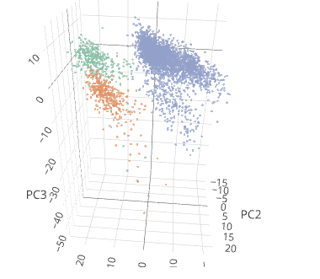
10X data – removed outliers -
focus on one group – 10x normalization
focus on one group
similar to no normalization
better separation of ALL samples
C2RT
New 4 Analysis Stations in « Aquarius »
Notes:
The cytometry and biomarkers unit of techbnology and service gathers a team of 6 engineers, 2 technicians and 1 bioinfo who provide support to the community through …..(see under activity). The work is focused around 28 state-of-the-art technologies installed in 6 dedicated laboratories. We are iso9001 –certified since 8 years. The specificity is that the facility aims to respond to…..(see in red). The concept is appreciated by the community that counts ……(see in blue)

Slide 10
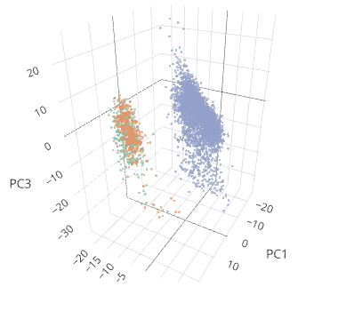
10X data – removed outliers -
focus on one group - scater
focus on one group
similar to no normalization
C2RT
New 4 Analysis Stations in « Aquarius »
Notes:
The cytometry and biomarkers unit of techbnology and service gathers a team of 6 engineers, 2 technicians and 1 bioinfo who provide support to the community through …..(see under activity). The work is focused around 28 state-of-the-art technologies installed in 6 dedicated laboratories. We are iso9001 –certified since 8 years. The specificity is that the facility aims to respond to…..(see in red). The concept is appreciated by the community that counts ……(see in blue)

Slide 11
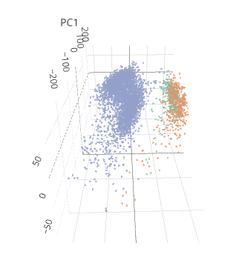
10X data – removed outliers -
focus on one group - DCA
focus on one group
similar to no normalization
C2RT
New 4 Analysis Stations in « Aquarius »
Notes:
The cytometry and biomarkers unit of techbnology and service gathers a team of 6 engineers, 2 technicians and 1 bioinfo who provide support to the community through …..(see under activity). The work is focused around 28 state-of-the-art technologies installed in 6 dedicated laboratories. We are iso9001 –certified since 8 years. The specificity is that the facility aims to respond to…..(see in red). The concept is appreciated by the community that counts ……(see in blue)

Slide 12
10X data
focus on group of genes for normalization
genes differentially expressing between clusters
remove genes that differentially express between samples.
Define difference between approaches
Average minimal distance between sample groups
need to implement some set-operations in scShinyHub
need to update the table output to enable easier selection of genes
C2RT
New 4 Analysis Stations in « Aquarius »
Notes:
The cytometry and biomarkers unit of techbnology and service gathers a team of 6 engineers, 2 technicians and 1 bioinfo who provide support to the community through …..(see under activity). The work is focused around 28 state-of-the-art technologies installed in 6 dedicated laboratories. We are iso9001 –certified since 8 years. The specificity is that the facility aims to respond to…..(see in red). The concept is appreciated by the community that counts ……(see in blue)

